Slide 1

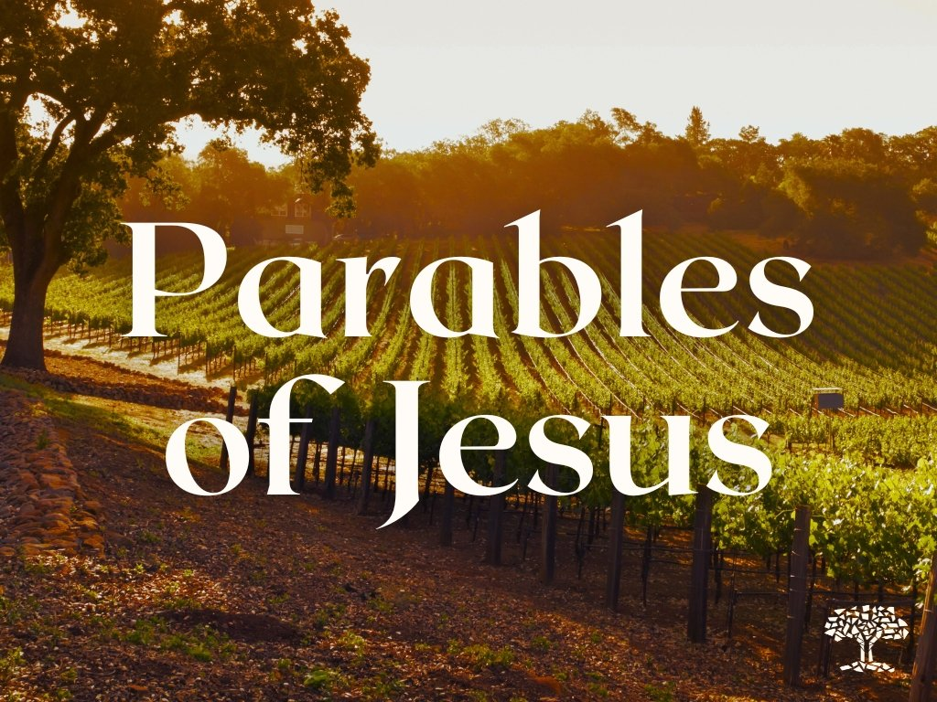

The Parable of the Mustard Seed and Yeast
Matthew 13:31-32

Slide 2

Matthew 13
The Seven Parables of the Kingdom
“He who has ears, let him hear.”
Matthew 13:1-23 The Parable of the Sower Matthew 13:24-30, 36-43 The Parable of the Weeds Matthew 13:31-32 The Parable of the Mustard Seed Matthew 13:33 The Parable of the Yeast Matthew 13:44-45 Parable of the Treasure & the Pearl Matthew 13:47-52 Parable of the Net

Slide 3
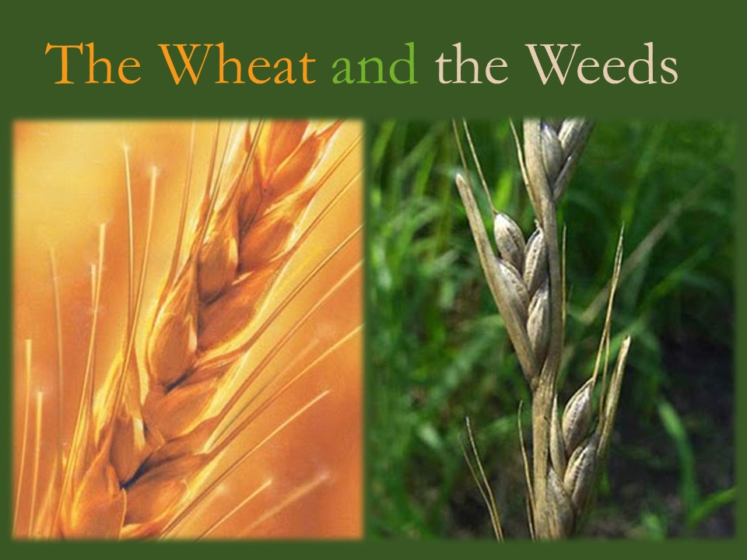
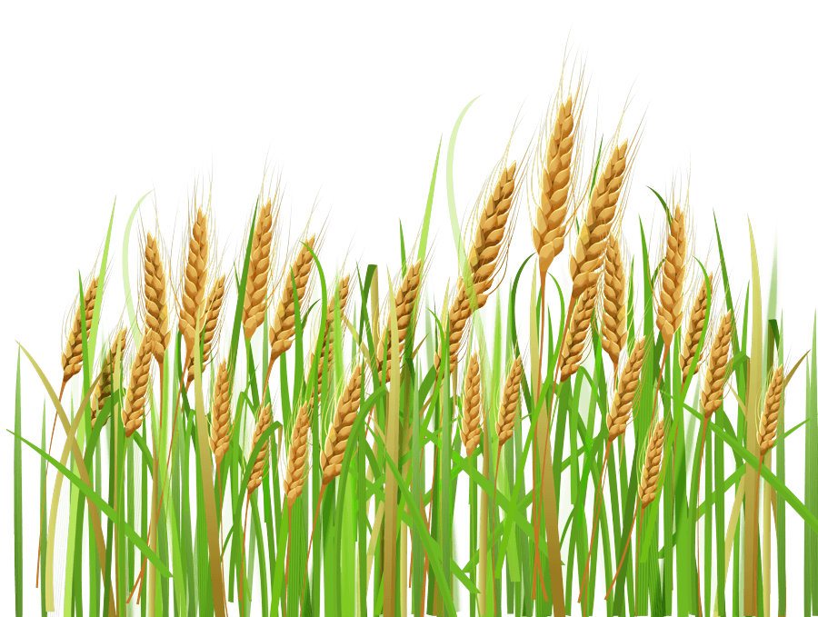
Parable of the Wheat and Weeds
Matthew
13:24-30; 36-43
Questions of Evil
How he gets here?
How he works?
How to live with him?
How to get rid of him?

Slide 4
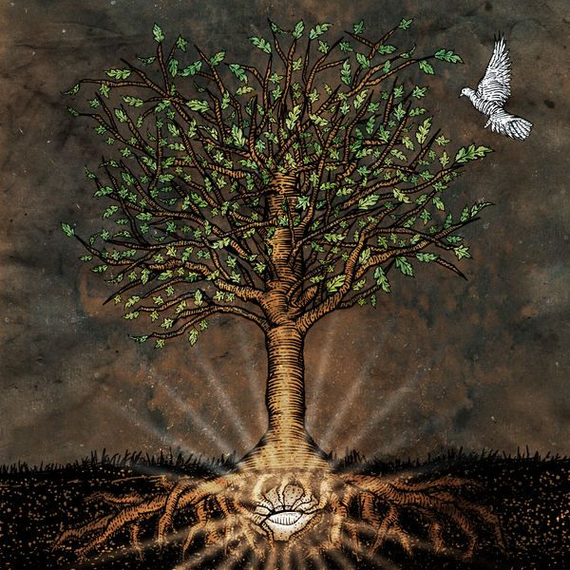
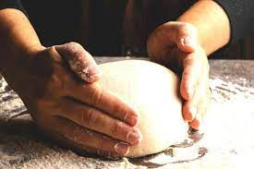
Matthew 13:31-33 Twin Parable
Expansion of the Kingdom of God
How much growth and significance to expect?
Parable of the Mustard Seed - Quantity
Parable of the Yeast - Quality

Slide 5
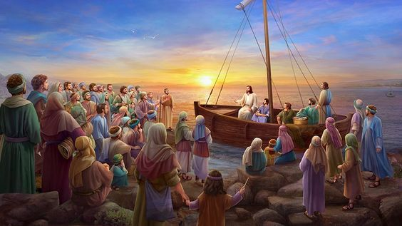
Matthew 13:31-33 The Parable of the Mustard Seed and Yeast
‘The kingdom of heaven is like a mustard seed, which a man took and planted in his field. ³² Though it is the smallest of all seeds, yet when it grows, it is the largest of garden plants and becomes a tree, so that the birds come and perch in its branches.’
³³ He told them still another parable: ‘The kingdom of heaven is like yeast that a woman took and mixed into about thirty kilograms of flour until it worked all through the dough.’

Slide 6
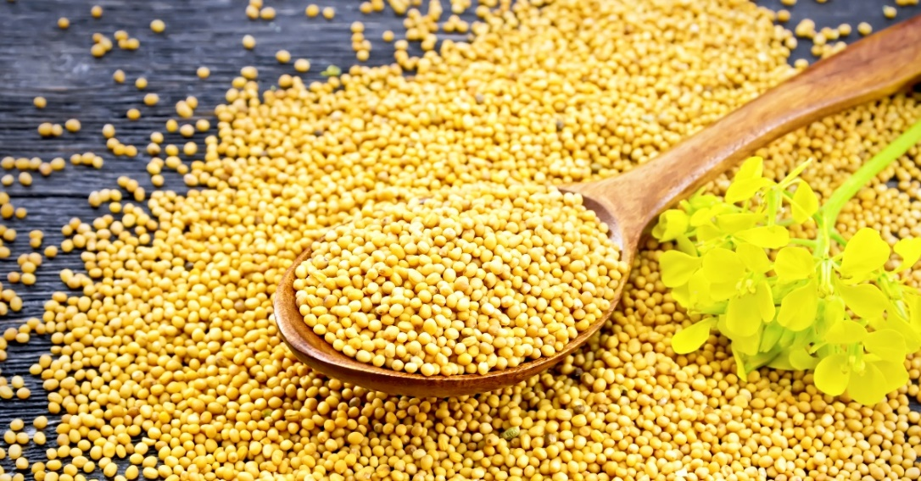
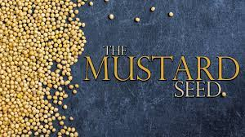
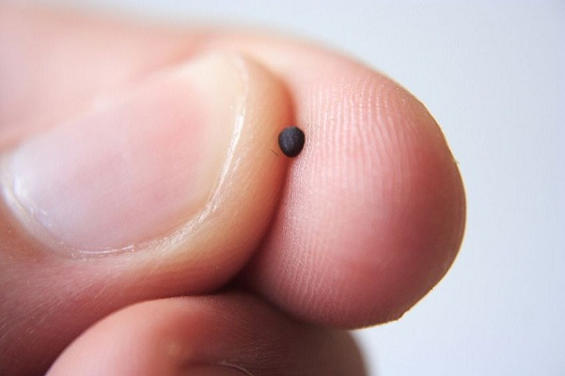
The Parables of the Mustard Seed
‘The kingdom of heaven is like a mustard seed, which a man took and planted in his field.
The Kingdom of God Starts Small

Slide 7
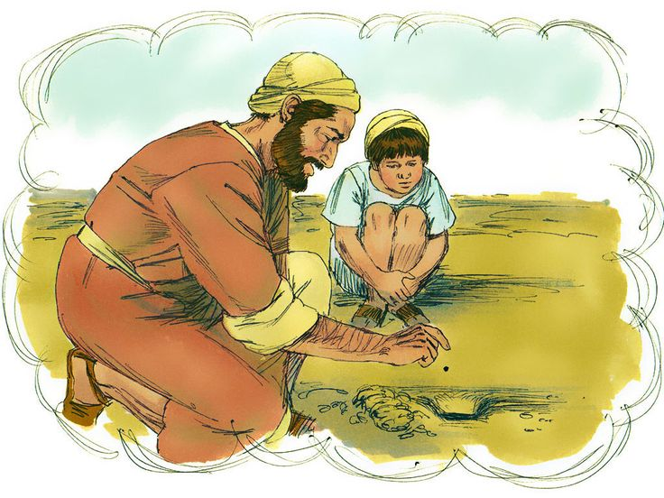
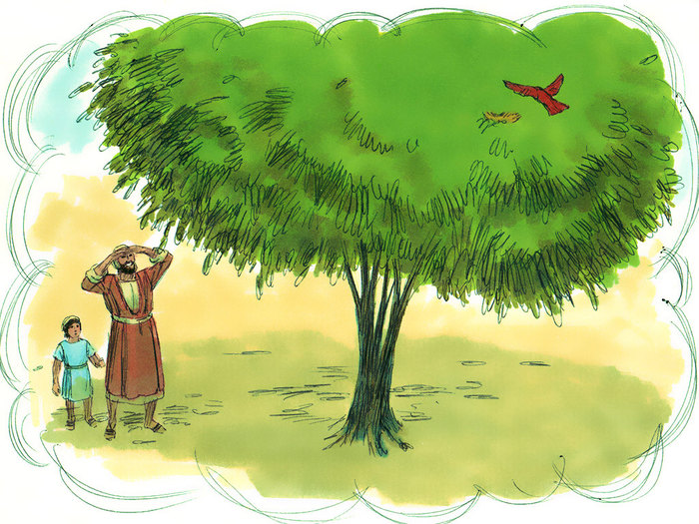
It Grows Surprising Large
³² Though it is the smallest of all seeds, yet when it grows, it is the largest of garden plants and becomes a tree, so that the birds come and perch in its branches.’
From Smallest to Largest
Birds in OT (Eze. 17:22-23)
Increased number of Gentiles in the kingdom

Slide 8
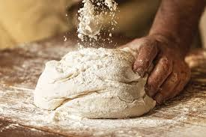
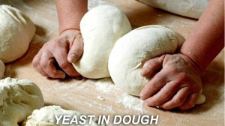
The Parables of the Yeast
³³ He told them still another parable:
‘The kingdom of heaven is like yeast that a woman took and mixed into about thirty kilograms of flour…
Yeast – Invisible Influence
The Kingdom of God Remains Hidden at First

Slide 9
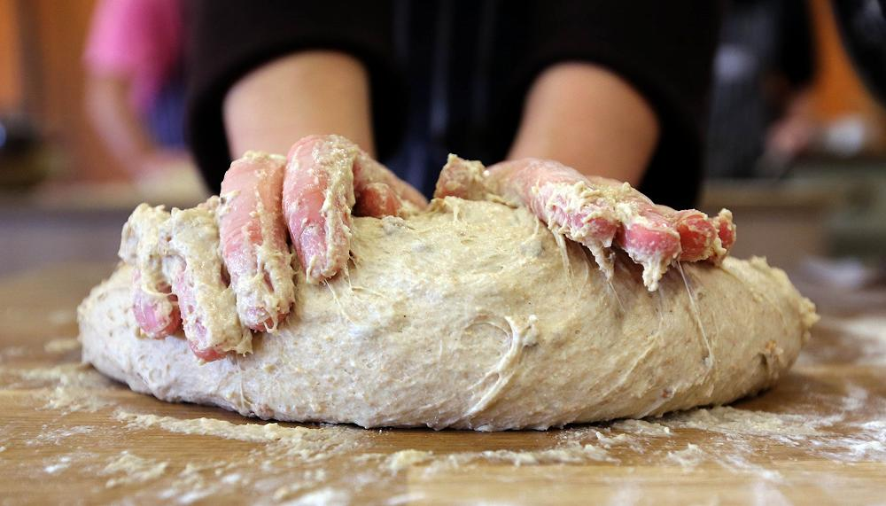
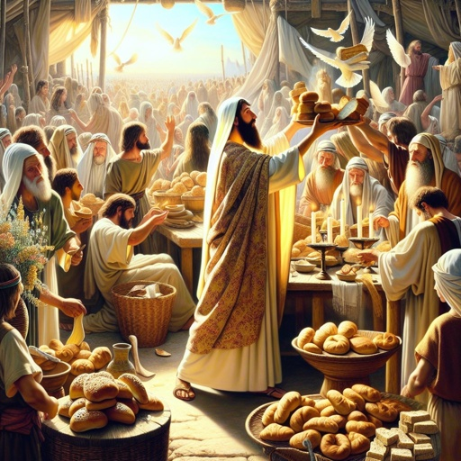
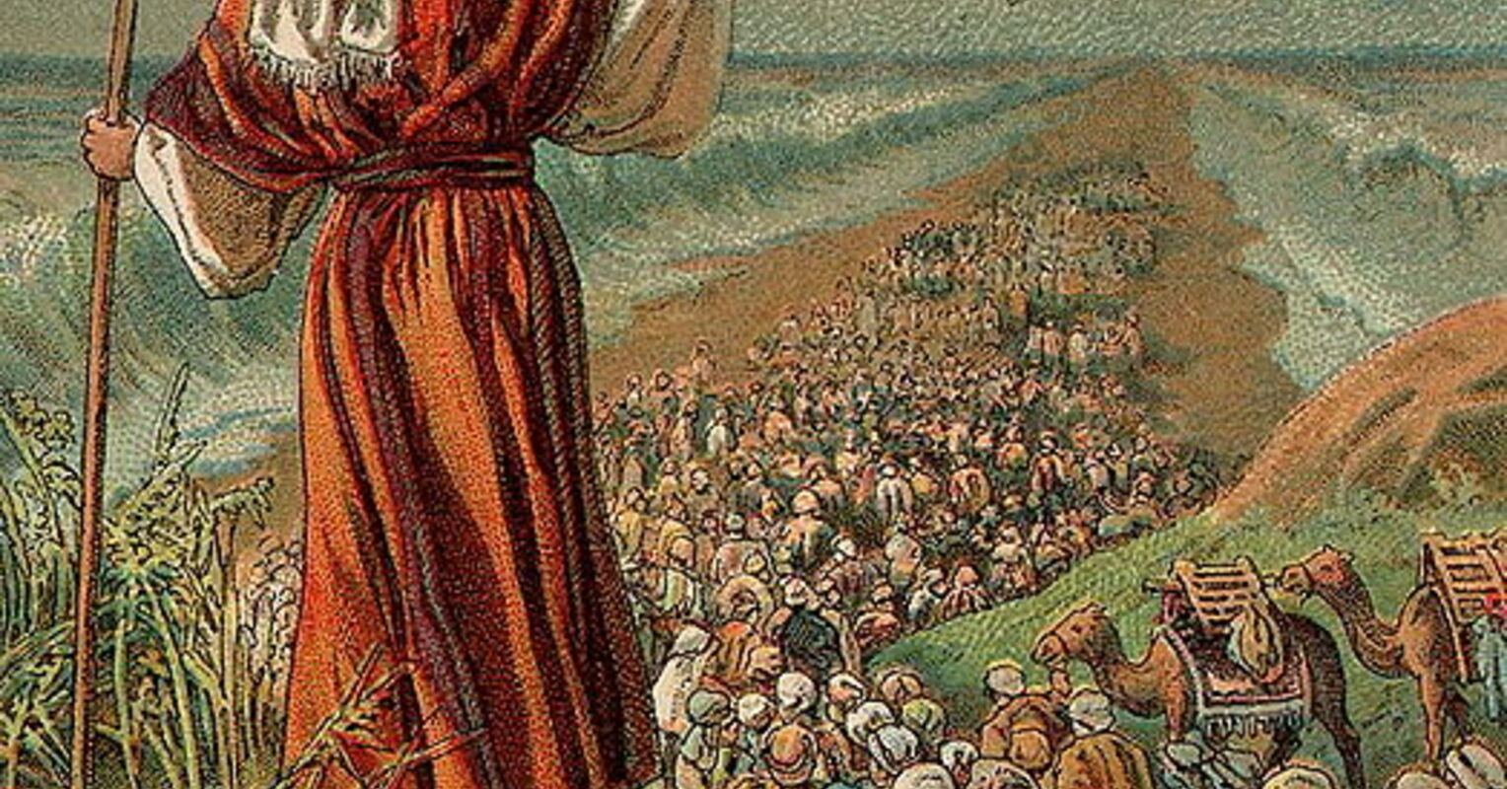
The Kingdom will spread deep and wide
until it worked all through the dough.’
Great Influence and Significance
Yeast is represented negatively
Exodus 12:15; 13:6-7 Feast of the Unleavened Bread/The Passover
Leviticus 2:11 Grain Offering without yeast
In NT – Hypocrisy and Sin

Slide 10
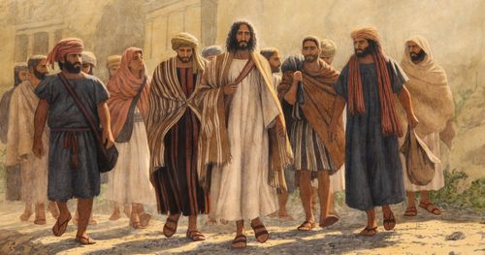
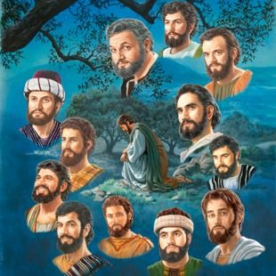
Look at the ‘Yeast of Jesus’
God uses the Ordinary and Despised
The disciples were the common uneducated fishermen, farmers, women, despised tax collectors, and fanatic zealot.

Slide 11

Expansion of the Kingdom
How much growth and significance to expect?
Parable of the Mustard Seeds
Quantitative Growth – He Multiplies!
Center of the Study of Global Christianity at Gordon-Conwell Theological Seminary
Population growth is 0.87% vs.
Christianity growth of 1.08%. (Africa 2.64%)
2.6 billion today. Projected to 3.3 billion in 2050.
Missionaries increase from 62,000 in 1900 to 445,000 today. Projected to 600,000 in 2050.

Slide 12
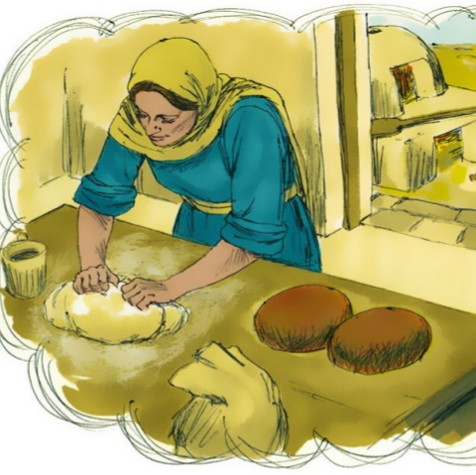
Parable of the Yeast
Quality Growth in Influence and Maturity
Invisible Influence
Hidden yet impactful significance

Slide 13


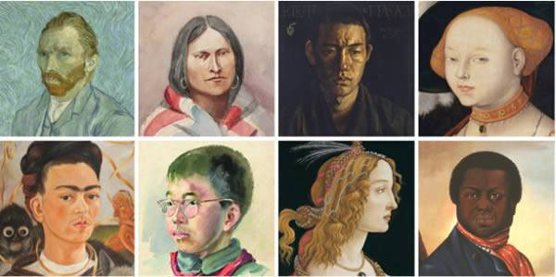

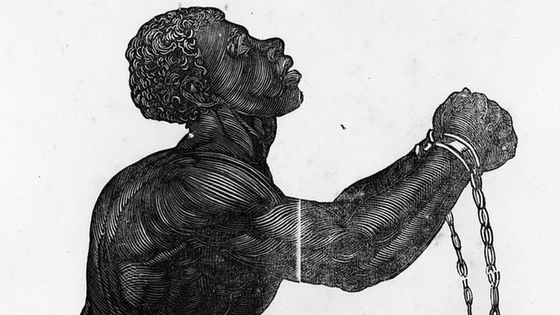
Influence of Christianity in Civilisation over the Centuries
Education, hospice, and medical care and social concern of aged and helpless.
Inspiration for literacy, science, music, art, culture, and philosophy.
Influence in politic, slavery, women right, law, commerce, family, marriage, vice and virtues.

Slide 14

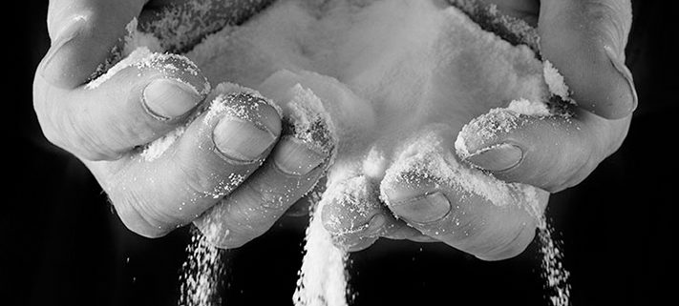
He uses the ‘Yeast’!
He Transforms!
From Ordinary & Despised People
To Beatitude Christians

Slide 15

Be Faithful and Fruitful Kingdom Disciples
Be the Mustard Seed
Dream Big, Start Small, Grow Deep
He is God of the How Much More

Slide 16

Be the ‘Yeast of Christ’ - Grow Deep
Be Disciples who disciple one another
Get Our Values and Priorities Right
Get Our Mission Clear
Get Our Motives Pure
Get Our Relationships Secure

Slide 17







Kingdom Disciples in…
GO! PRAY and WORK!
Make a difference in the community
Family, workplace, finance, politic, education, entertainment and the arts, social media…

Slide 18

Build His Kingdom Here!
Be the Mustard Seed and Yeast
Go Mission with God

